Slide 1
Mood Recognition System
Project Supervisor: Dr. Akash Rajak
Notes:
Hello Good Morning to everyone present here. I Divyansh Bhatnagar with my team is going to demonstrate our project which is done under the supervision of Dr. Akash Rajak.

Slide 2
The Team
Divyansh Bhatnagar 2000290140042
Ayushi Singhal 2000290140036
Tarunima Sharma 2000290140126
Akshay Singh 2000290140014
Notes:
Now in our team we have 4 members including me, Ayushi , Tarunima , Akshay.
Now Ayushi will be introducing our project to give you some insight into our project.
We have all given our collective effort towards this project.
The Actual Demonstration will be done by Akshay using his laptop.

Slide 3

Introduction
Facial expressions play a significant role in human dialogue. As a result, there has been considerable work done on the recognition of emotional expressions and the application of this research will be beneficial in improving human-machine dialogue.
Notes:
Ayushi

Slide 4
Introduction
One can imagine the improvements to computer interfaces, automated clinical (psychological) research or even interactions between humans and autonomous robots.
Notes:
Ayushi

Slide 5

SYSTEM ARCHITECTURE
Capture Image
Faces detected
Display of emotion for each face
Classification
Feature Extraction
Notes:
Ayushi

Slide 6
Module Description
Preprocessing Image.
The system involves pre-processing image data by normalizing and applying a simple mask, extracting certain (facial) features and then using SVMs for classification and recognition of expressions.
Notes:
Akshay
In this project we develop our own mood detection system that addresses this challenge.
SVM - In machine learning, support-vector machines are supervised learning models with associated learning algorithms that analyze data for classification and regression analysis.

Slide 7
Module Description
Extraction of Mood/Emotion.
Eigenfaces for each class are used to determine class-specific masks which are then applied to the image data and used to train multiple, one against the rest, SVMs. We find that simply using normalized pixel intensities works well with such an approach

Slide 8
DATA FLOW DIAGRAM
MOOD
RECOGNITION SYSTEM
IMAGE
EMOTION DETECTED
LEVEL 0
Notes:
Divyansh

Slide 9
DATA FLOW DIAGRAM
CAPTURE IMAGE
USER
IMAGE CAPTURED
EMOTION DETECTION
EMOTION DETECTED
LEVEL 1
Notes:
Divyansh

Slide 10
DATA FLOW DIAGRAM
LEVEL 2
Face Detector
Face Acquisition
USER
FRAMES
Detected Face
Classifier
Feature Extractor
EMOTION DETECTED
Features
Notes:
Divyansh

Slide 11
USE CASE DIAGRAM
Stand In Front of Webcam
Show Proper Emotion
Emotion Detected
Notes:
Ayushi

Slide 12
Hardware Requirements / Hardware Used
Central Processing Unit (CPU) - Intel Core i5 6th gen or AMD processor equivalent
RAM - 8 GB minimum, 16 GB or higher is recommended.
Graphics Processing Unit (GPU) - NVIDIA GeForce GTX 960 or higher
Inbuilt Camera or Webcam Support
Operating System (OS) - — Ubuntu or Microsoft Windows 1
Storage - 20 GB
Notes:
Akshay

Slide 13
Technologies / Software Requirements
Python 3 or above
Library - open cv
Mood Recognition System
Notes:
Akshay

Slide 14

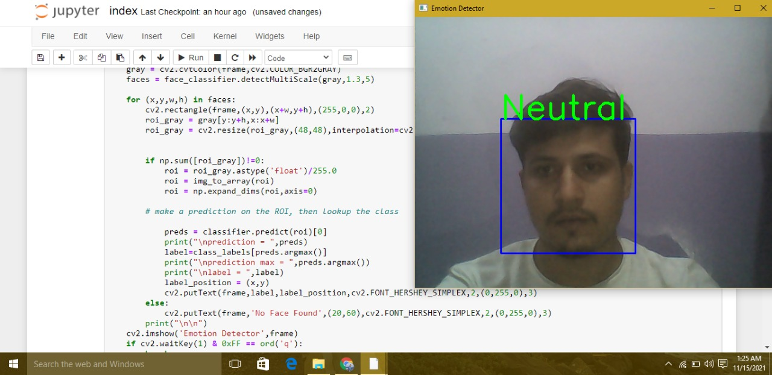
Reports / Outputs
Notes:
Akshay Actual Presentation

Slide 15
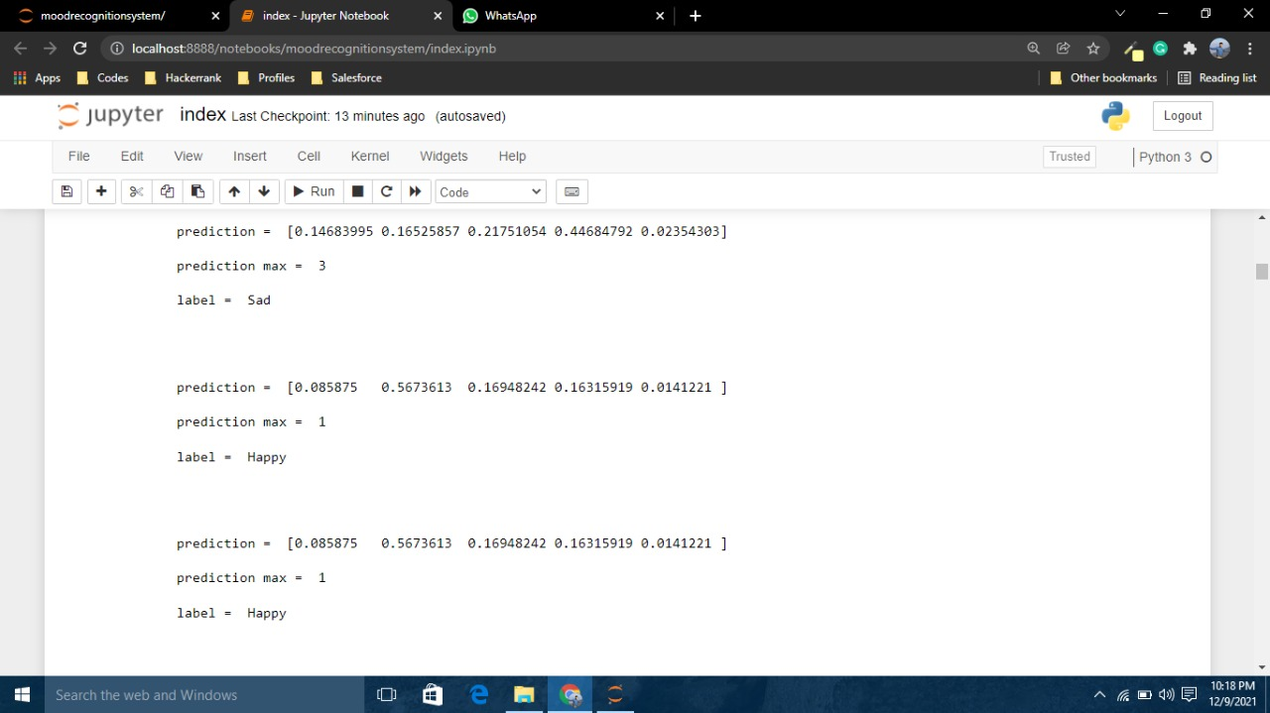
Reports / Outputs 2
Notes:
Akshay Actual Presentation
It could in theory will be able to detect the emotions of a still picture using image analysis. This and the next output pic depicts the emotion analysis from the still images of the face of people.

Slide 16
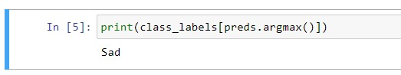
Reports / Outputs 3
Notes:
Akshay Actual Presentation

Slide 17

How will it serve the Society ?
Reducing Stress.
Creating Smiles
Notes:
Tarunima
1.This is a big question now a days as every project should be made to help society in some manner. Our project is same in that prospect
2.Reducing Stress : It will help society in controlling their emotions as we all know we can reduce stress just by making a smile.
3.Making More Smile: Sometimes we just need someone to remind us to smile more which this can

Slide 18
Conclusion
Finally we can say that our mood almost always dictates our action and our software will help in detecting the person’s mood so that person can relax and make more informed decisions
Notes:
Tarunima
Emotions Affect almost every actions that we perform .
It also affects our mental health.

Slide 19
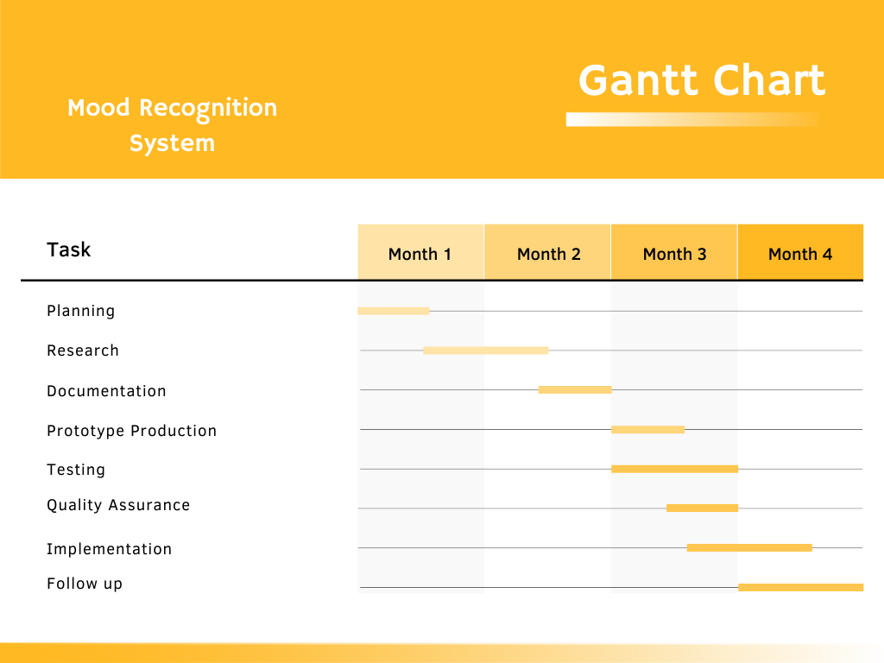
Gantt Chart
Notes:
Divyansh
This is our gantt chart for this project showing the progress of the project from planning to completion and follow up for maintenance.
The duration of this project is from Sept to December 2nd week.
We have alre
Documentation is still ongoing as initial synopsis and srs are done
We’ll be starting the coding of this project after the holidays . probably from the 2nd week of nov

Slide 20

Thank You

